Slide 1

Bright tv analysis
Power BI visuals

Slide 2
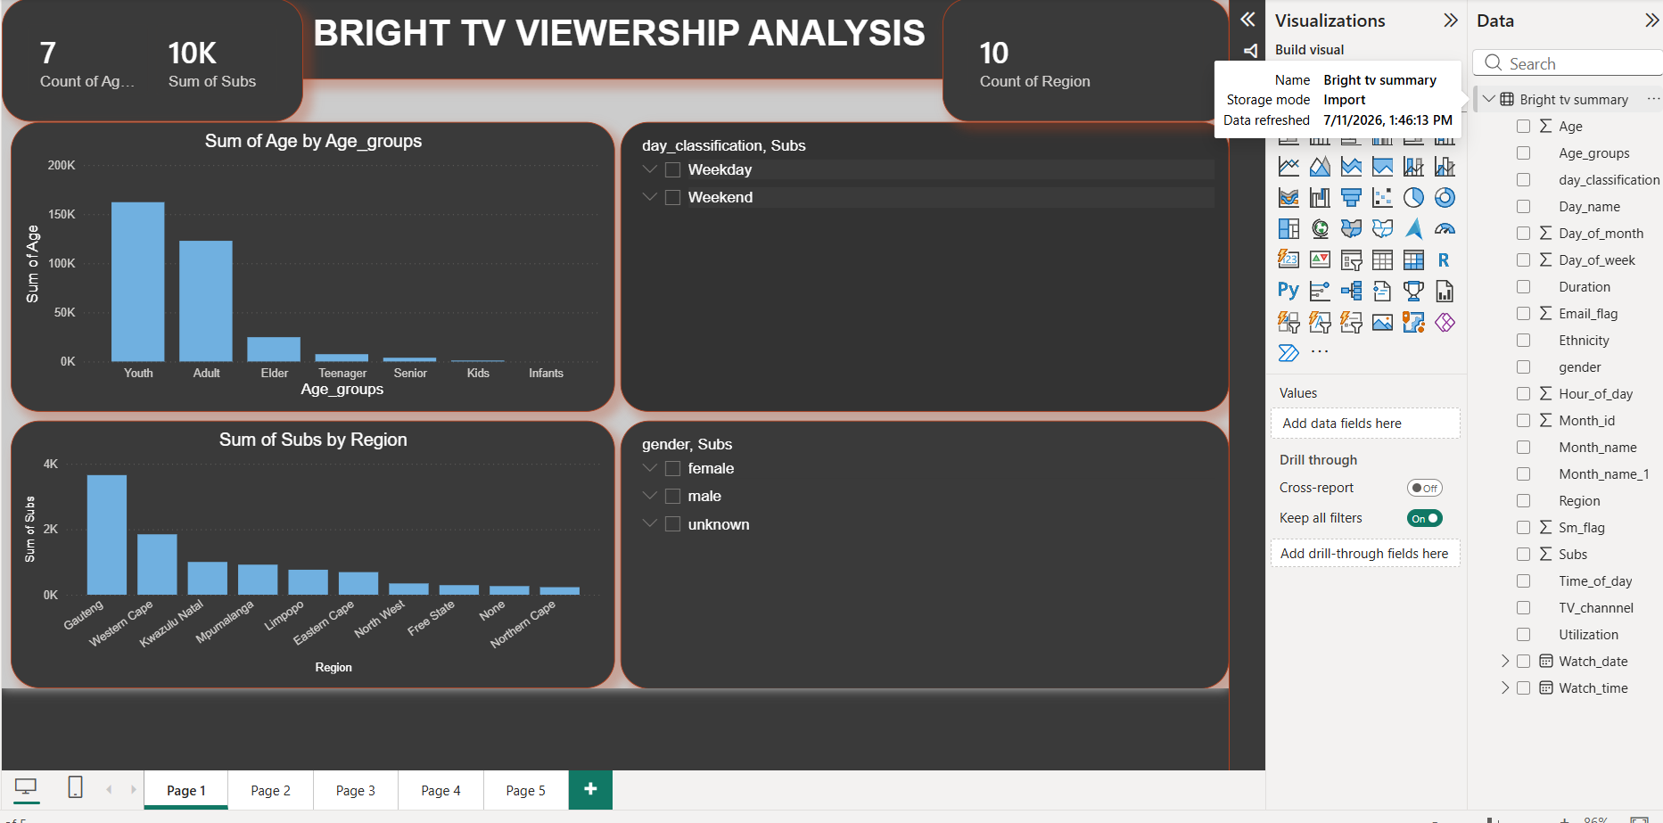
Age groups and Subs by region
There 7 Age groups, 10K Subs and 10 count of regions
Slicer for day classification to analyze which day classification has more views.
Slicer on gender to analyze which gender views the most between weekdays and weekends.

Slide 3
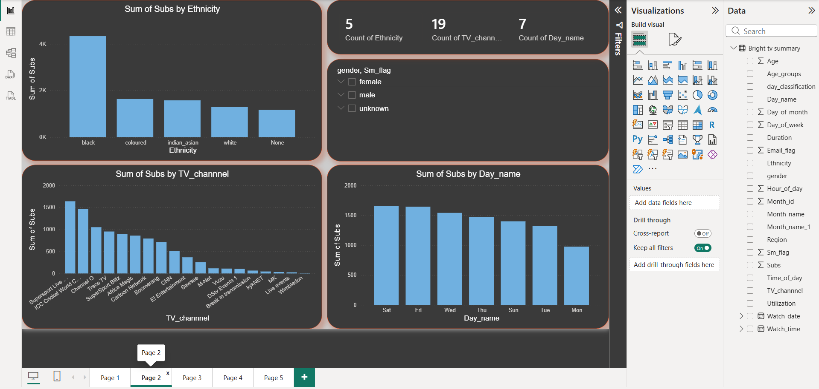
Ethnicity groups and Subs by channel
There 5 race groups, 19 channels and 7 count of day names.
Slicer on gender to analyze which gender views the most between day names and channels.

Slide 4
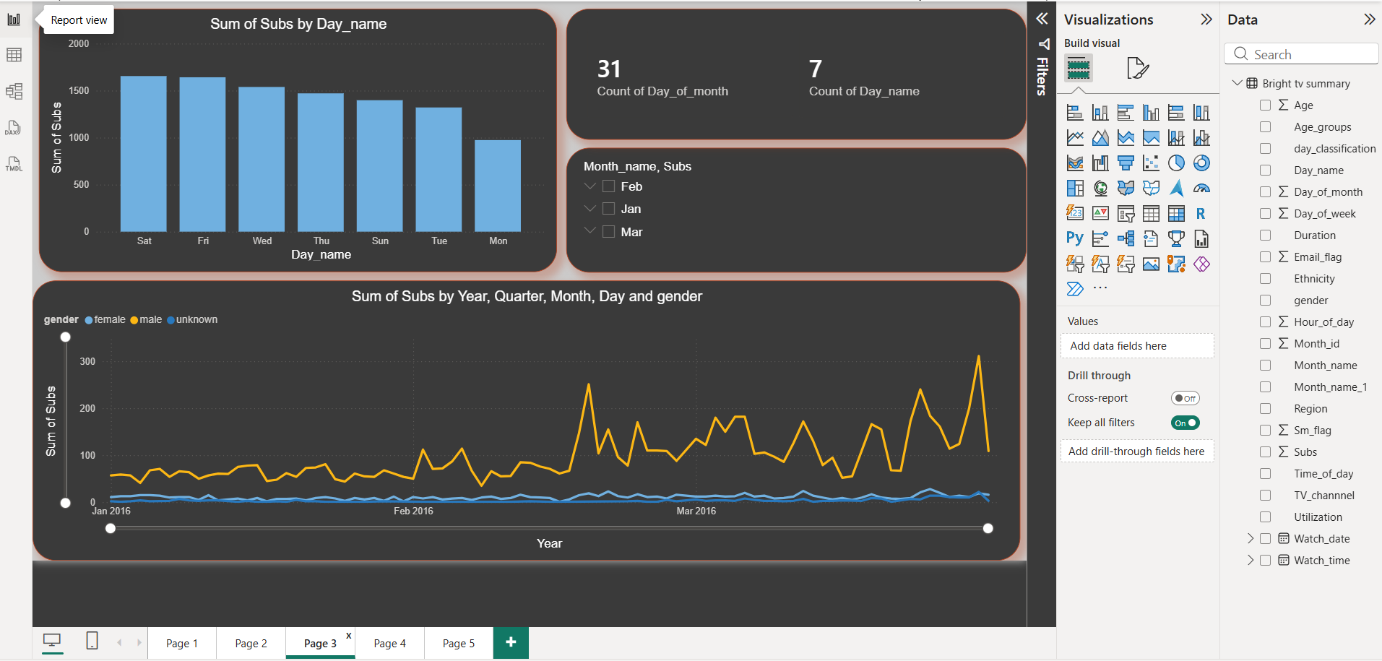
Subs viewing per day and most viewing gender p/m.
Count of days of month 31 and count of days per week which 7.
Month name slicer to analyze zoom in on a number of subscribers per day.

Slide 5
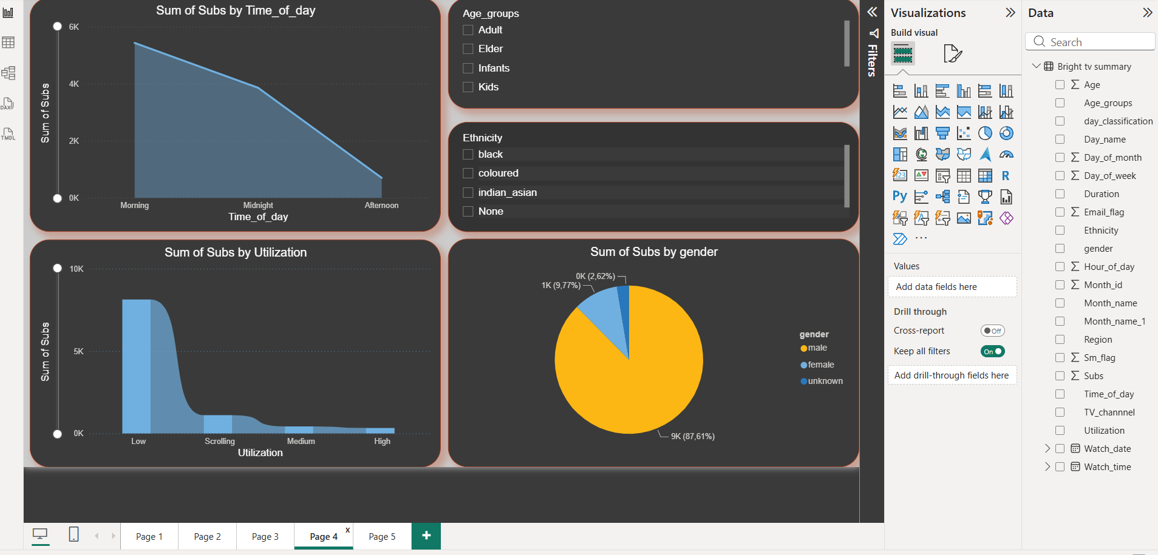
Subs by time of day and the utilization.
Slicer for age groups to analyze which group views and utilize the most.
Slicer on race to analyze which race utilize the tv and on which period of the day.

Slide 6
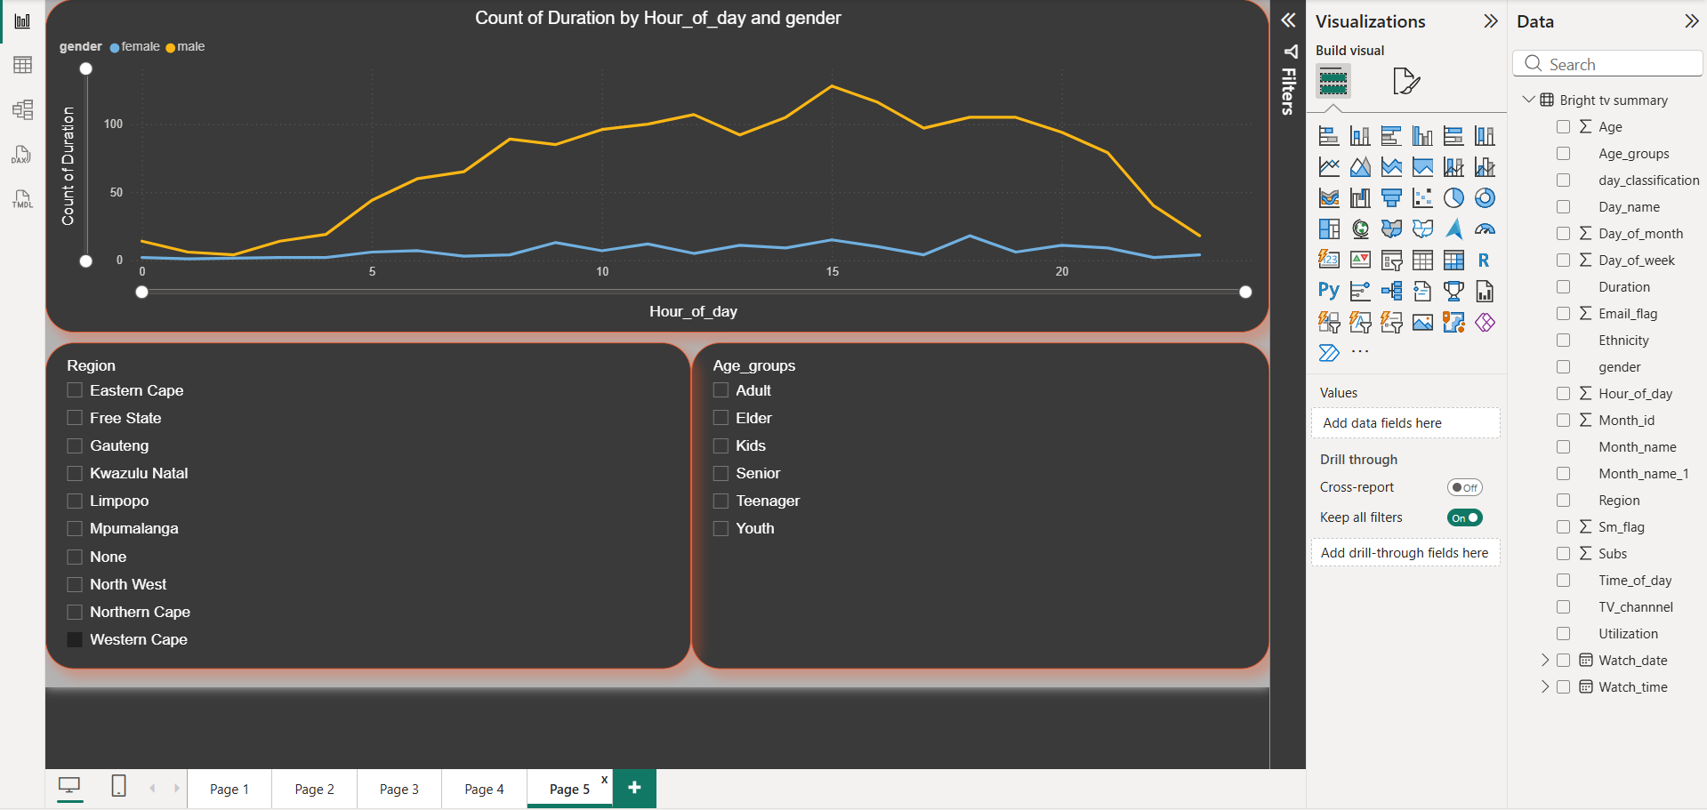
Count of duration by hour of the day and gender.
The slide is to show the peek hour regarding views and by which gender.
Slicer for region and age groups to analyze which Province uses the most or least television.

Slide 7

conclusion
Based on the attached Bright TV analysis, the Power BI dashboard provides a strong and positive overview of subscriber viewership and engagement patterns.
The analysis demonstrates that Bright TV has a broad and active subscriber base across multiple regions, age groups, genders, and channels. The interactive Power BI visuals successfully highlight key viewing trends, including peak viewing periods, subscriber activity by day and month, content utilization, and demographic preferences. These insights enable a deeper understanding of audience behaviour and support informed decision-making for content planning, marketing strategies, and operational improvements. Overall, the findings indicate healthy viewer engagement and provide a valuable foundation for Bright TV to optimize programming, enhance customer satisfaction, and drive continued growth.

